Slide 1

Daily Meal Solutions
Project (KCS-753)
Project Id: 22B12
Submitted to:
Mr. Saumendu Bose
Team Members:
Abhinav Shukla (1816410011)
Akashdeep Soni (1816410036)
Anubhav Srivastava (1816410064)
Varchasv Shukla (1816410307)
Branch: CS - IV

Slide 2

Daily Meal Solutions

Slide 3
Table of Contents
Objective
Importance and Need
Methodology
Technology Domain
ARCHITECTURE
Hardware/Software Specifications
Feasibility Study
Academic Objectives
Project Flow Diagram
Flow Chart
Snapshots
Results and Conclusion
References

Slide 4
Objective
Hunger is a felling of discomfort caused by lack of food and desire to eat.
It is detrimental to child’s ability to learn grow and stay healthy.
People go hungry because of inflation,high food prices,climate change diminishing natural resoruce and many other factors .
The objective of the project is to provide daily meal to the people who are hungry, people who are not able to cook their own meal on a daily basis and are looking for a daily meal solution.

Slide 5
Importance and Need
As nowadays, we see in india the number of people living outside their home is increasing day by day. They are not able to make their food on the daily basis. This seems to be a big problem sometimes when it comes to time management, as cooking food requires much time and effort.
Students living far from their home try to subscribe the tiffin services, but sometimes it becomes very difficult for them to find a tiffin service that provides quality, hygienic and healthy food.
So the above problem for students and the working sector of our country encourages us to bring such a solution that resolves the above problem.
The primary reason to choose this topic is that it will somewhere save the time of people and will ensure a quality and healthy meal.

Slide 6
Methodology
The user and the food provider both will be having different interfaces, the user will order from its end and the food provider will come to know about the orders.
When it comes to daily subscriptions the there is no need to order daily the order will be delivered based on the plan subscribed.
For any kind of changes to the meal or any kind of other requests, there will be another section to the user interface.

Slide 7
Technology Domain
Technology
Web Application / Web Services
Stack
MERN (MongoDB, Express, React, Node)
Frontend
React.js
Backend
Node.js
Express.js (Framework)
Database
MongoDB
Mongoose (ODM)

Slide 8
MERN Stack:
MERN Stack: MERN Stack is a Javascript Stack that is used for easier and faster deployment of full-stack web applications. MERN Stack comprises of 4 technologies namely: MongoDB, Express, React and Node.js. It is designed to make the development process smoother and easier.
Each of these 4 powerful technologies provides an end-to-end framework for the developers to work in and each of these technologies play a big part in the development of web applications.

Slide 9
MongoDB :
MongoDB: Cross-platform Document-Oriented Database MongoDB is a NoSQL database where each record is a document comprising of key-value pairs that are similar to JSON (JavaScript Object Notation) objects. MongoDB is flexible and allows its users to create schema, databases, tables, etc. Documents that are identifiable by a primary key make up the basic unit of MongoDB. Once MongoDB is installed, users can make use of Mongo shell as well. Mongo shell provides a JavaScript interface through which the users can interact and carry out operations (eg: querying, updating records, deleting records).

Slide 10
Express: Back-End Framework:
Express is a Node.js framework. Rather than writing the code using Node.js and creating loads of Node modules, Express makes it simpler and easier to write the back-end code. Express helps in designing great web applications and APIs. Express supports many middlewares which makes the code shorter and easier to write.
Why use Express?
Asynchronous and Single-threaded.
Efficient, fast & scalable
Has the biggest community for Node.js
Express promotes code reusability with its built-in router.
Robust API
Create a new folder to start your express project and type below command in the command prompt to initialize a package.json file. Accept the default settings and continue.

Slide 11
React: Front-End Library :
React is a JavaScript library that is used for building user interfaces. React is used for the development of single-page applications and mobile applications because of its ability to handle rapidly changing data. React allows users to code in JavaScript and create UI components.
Why use React?
Virtual DOM – A virtual DOM object is a representation of a DOM object. Virtual DOM is actually a copy of the original DOM. Any modification in the web application causes the entire UI to re-render the virtual DOM. Then the difference between the original DOM and this virtual DOM is compared and the changes are made accordingly to the original DOM.
JSX – Stands for JavaScript XML. It is an HTML/XML JavaScript Extension which is used in React. Makes it easier and simpler to write React components.
Components – ReactJS supports Components. Components are the building blocks of UI wherein each component has a logic and contributes to the overall UI. These components also promote code reusability and make the overall web application easier to understand.

Slide 12
Node.js: A runtime Environment :
Node.js: JS Runtime Environment Node.js provides a JavaScript Environment which allows the user to run their code on the server (outside the browser). Node pack manager i.e. npm allows the user to choose from thousands of free packages (node modules) to download.
Why use Node.JS?
Open-source JavaScript Runtime Environment
Single threading – Follows a single-threaded model.
Data Streaming
Fast – Built on Google Chrome’s JavaScript Engine, Node.js has a fast code execution.
Highly Scalable
Initialize a Node.js application by typing running the below command in the command window. Accept the standard settings.

Slide 13
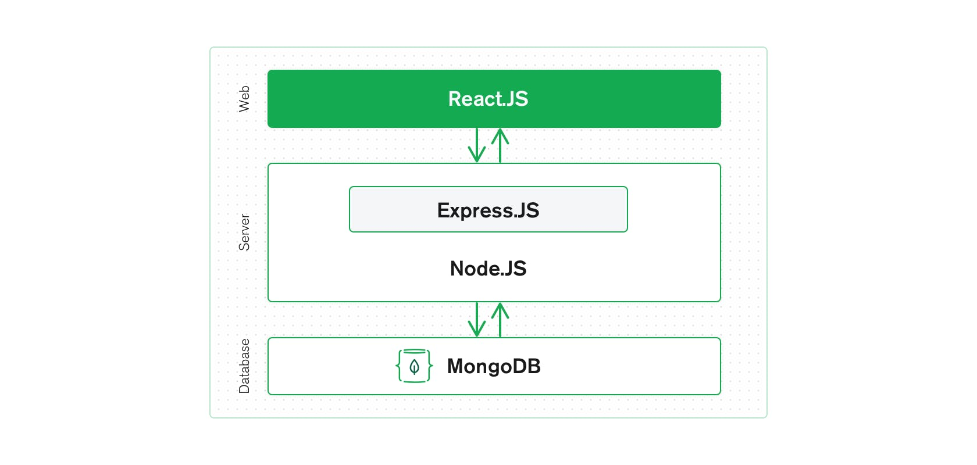
Architecture

Slide 14
Hardware / Software Specification
Hardware used
Processor: i3 or better
RAM: 2GB or more
Storage: 2GB or more
Software used
Editor: Visual Studio Code
Browser: Chrome or Firefox
Version Control: Git

Slide 15
Feasibility Study
Technical feasibility – Project is technically feasible as all the technical requirements have been analysed and are easily obtainable.
Operational feasibility – Project is operationally feasible as the project will contain an easy to use gui and a guide.
Economic feasibility – project is economically feasible as it will be build using open source softwares and library which are free to use.
Legal feasibility – Project is legally feasible as all modules used permit usage from open source and non-monetized applications.
Schedule feasibility – Project is schedule feasible as the project can be completed within the said deadline.

Slide 16
Academic Objectives
Devlope a web app which has the full stack capability.
Web App will have frontend, backend and database.
Develope the frontend using react.js framework
Develope the backend using express.js framework
Develope the database using Mongoose ODM.

Slide 17
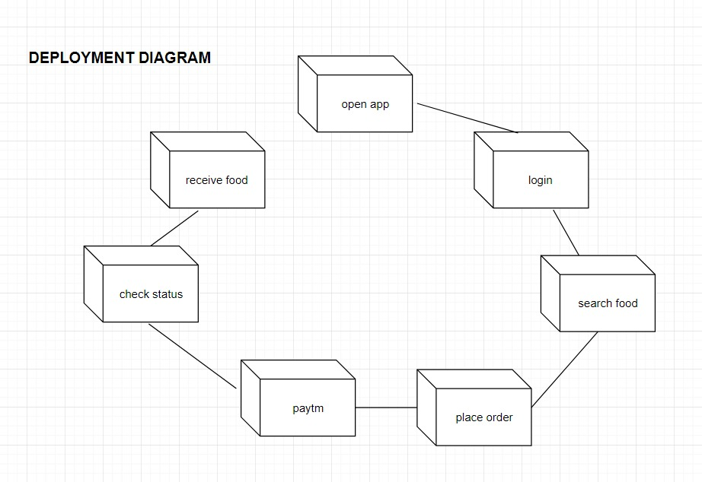
Project Flow Diagram

Slide 18
Home
Flow Chart
Item
Item = 0
Select
Product
Menu
My Cart
Continue
Shopping
Item > 0
Login
No
Select
Category
Proceed to
Checkout
Sign In
Yes
Correct
View Product
Payment
Information
Add to Cart
Yes
No
Review
Order
Order
Confirmation
Check Out

Slide 19
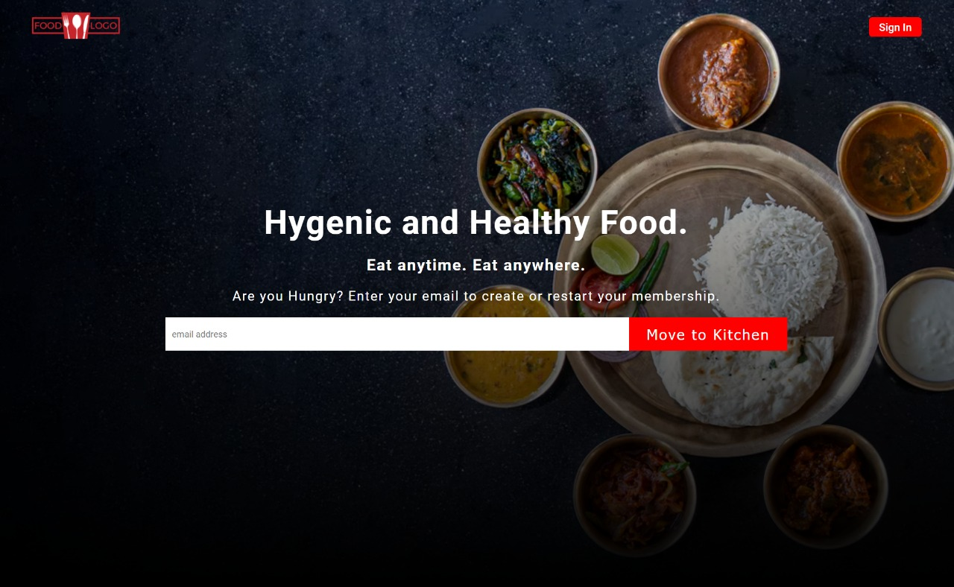
Snapshots

Slide 20
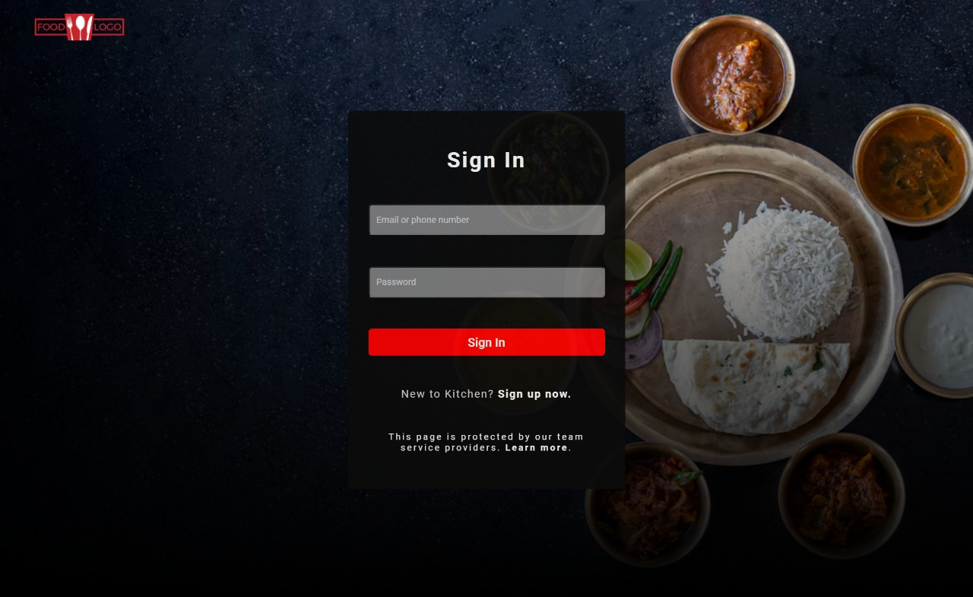
Snapshots (Cont...)

Slide 21
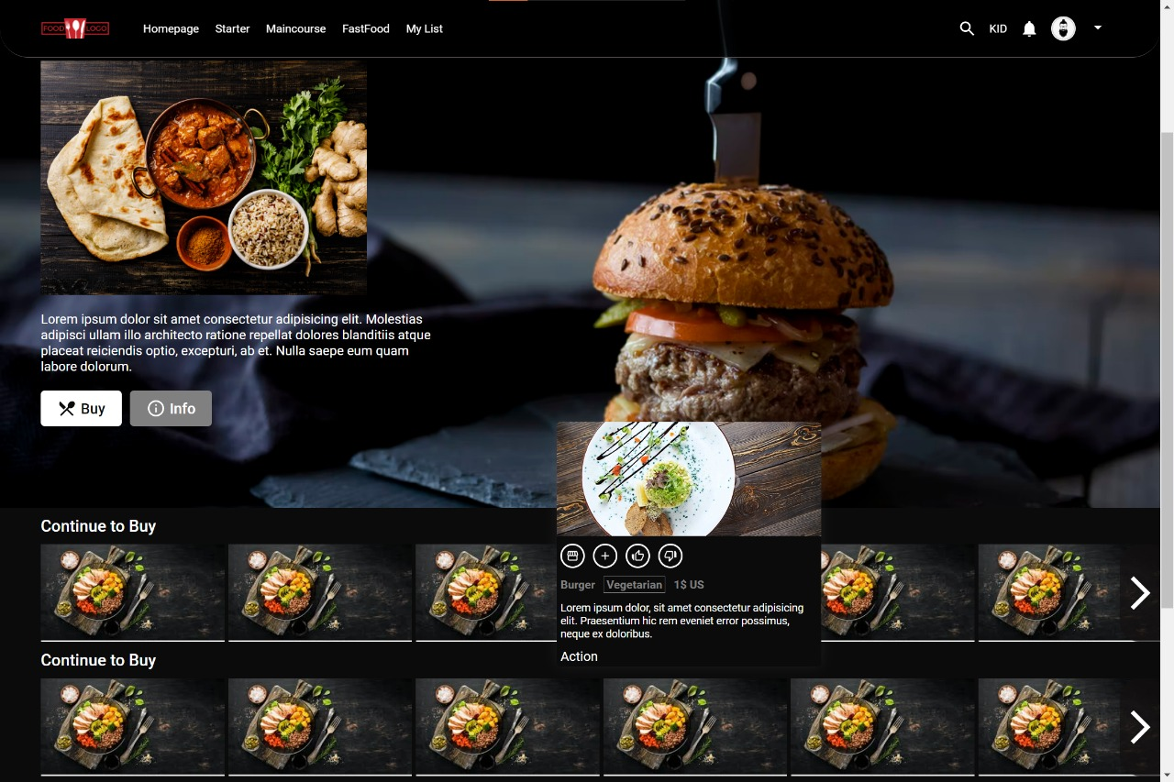
Snapshots (Cont...)

Slide 22
Future Scope
The project will be providing a daily meal solution. The user will be having an interface to order or subscribe for the tiffin services. The customer will be able to subscribe to the tiffin services on the monthly basis or if want to make some changes to his current tiffin then he can order a customized tiffin. There will be different plans of tiffin, one can subscribe to the food services according to their will by choosing a plan.
There is also one more goal of this project to employ a crowd, so in the future, we may contact and partner with the different small-scale hotel (Dhaba) owners to increase their area of services.

Slide 23
Results and Conclusion
We were successfully able to design a web app having full stack capabilites
This app can be used to search food category wise and and add it to the cart.
When the cart is not empty we can review our meal and proceed to checkout.
After checking out we can enjoy our meal at our place.

Slide 24
References
MDN Web Docs
https://developer.mozilla.org/en-US/
W3Schools Online Web Tutorials
https://www.w3schools.com/
The Complete 2022 Web Development
https://www.udemy.com/course/the-complete-web-development-bootcamp/
Burdman, Jessica, “Collaborative Web Development” Addison Wesley
Xavier, C, “ Web Technology and Design” , New Age International

